Slide 1
Gradiant Boosting
Regressor

Slide 2
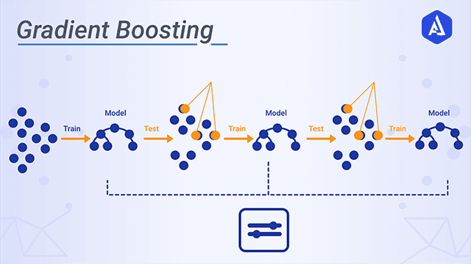
What is gradient boosting regressor?
Gradient boosting is a machine learning technique used in regression and classification tasks, among others. It gives a prediction model in the form of an ensemble of weak prediction models, i.e., models that make very few assumptions about the data, which are typically simple decision trees.

Slide 3
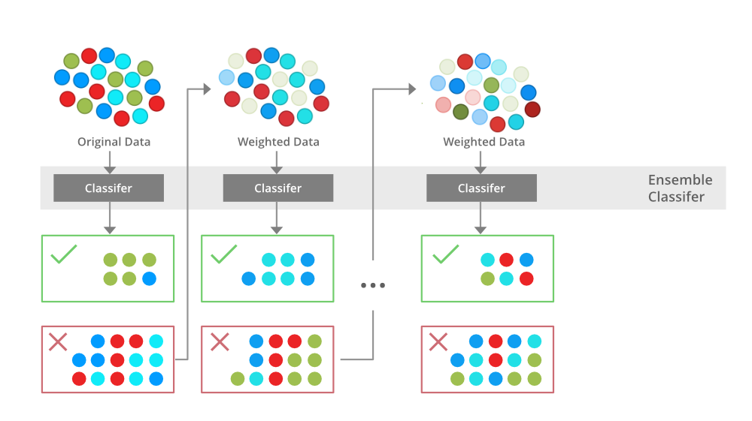
XGBoost works
Boosting refers to any Ensemble Method that can combine several weak learners(a predictor with poor accuracy) to make a strong learner(a predictor with high accuracy). The idea behind boosting is to train models sequentially, each trying to correct its predecessor.

Slide 4
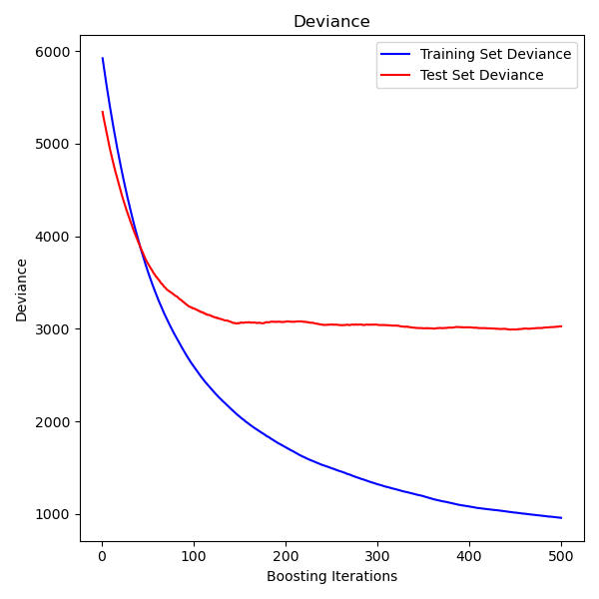
Learning Curves for the XGBoost Model with Smaller Learning Rate

Slide 5
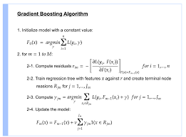

Slide 6
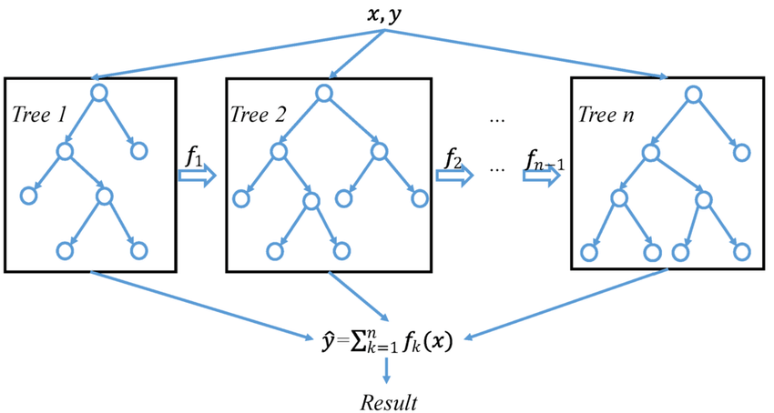
A general architecture of XGBoost

